Slide 1
Euler Paths and Circuits
（欧拉路径与欧拉回路）

Slide 2
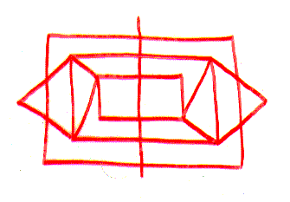

Problem
Can I draw the figure in one continuous trace with no line being drawn twice?
*
School of Computer Science, BUPT
*

Slide 3
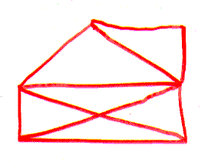

Problem
How about this one?
*
School of Computer Science, BUPT
*

Slide 4
Königsberg Bridge problem
The residents of Königsberg, Germany, wondered if it was possible to take a walking tour of the town that crossed each of the seven bridges over the Pregel River exactly once.
  Leonard Euler 1736 (father of graph theory)
*
School of Computer Science, BUPT
*

Slide 5
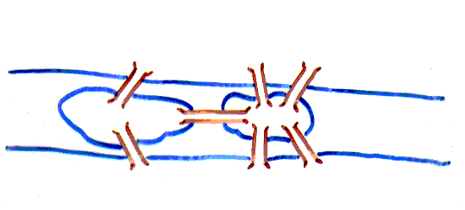
Königsberg Bridge problem
Picture only what is essential to the problem.
*
School of Computer Science, BUPT
*

Slide 6
Königsberg Bridge problem
Is it possible to start at some node and take a walk that uses each edge exactly once, and ends at the starting node?
*
School of Computer Science, BUPT
*

Slide 7
Königsberg Bridge problem
You can redraw the original picture as long as for every edge between nodes i and j in the original you put an edge between nodes i and j in the redrawn version (and you put no other edges in the redrawn version)
1
2
2
3
4
1
3
4
*
School of Computer Science, BUPT
*

Slide 8
Can you see why?
Euler
  Has no tour that uses each edge exactly once.
  (Even if we allow the walk to start and finish in different places.)
*
School of Computer Science, BUPT
*

Slide 9
Eulerian graph（欧拉图）
An Euler circuit in a graph G is a simple circuit containing every edge of G.
An Euler path in G is a simple path containing every edge of G.
A walk in a graph is called an Euler tour if it starts and ends in the same place and uses each edge exactly once.
A walk in a graph is called an Euler trail if it uses each edge exactly once.
If a graph has an Euler tour, it is said to be an Eulerian graph.
*
School of Computer Science, BUPT
*

Slide 10
Eulerian graph
*
School of Computer Science, BUPT
*

Slide 11
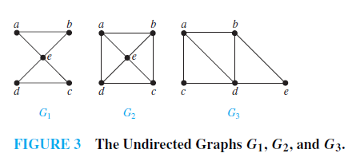
Example 1
Which of the undirected graphs in Figure 3 have an Euler circuit? Of those that do not, which have an Euler path?
*
School of Computer Science, BUPT
*

Slide 12
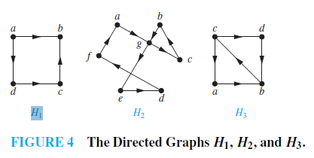
Example 2
Which of the directed graphs in Figure 4 have an Euler circuit? Of those that do not, which have an Euler path?
*
School of Computer Science, BUPT
*

Slide 13
The problem in our language
Show that is not Eulerian.
In fact, it contains no Euler trail.
*
School of Computer Science, BUPT
*

Slide 14

Theorem
1. A connected graph G is Eulerian
G is connected and has no vertices of odd degree
2. A connected graph G has an Euler trail from node a to some other node b
G is connected and a ≠ b are the only two nodes of odd degree
*
School of Computer Science, BUPT
*

Slide 15
Proof of ⇓
Assume G has an Euler trail T from node a to node b (a and b not necessarily distinct).
For every node besides a and b, T uses an edge to exit for each edge it uses to enter. Thus, the degree of the node is even.
1. If a = b, then a also has even degree.
2. If a ≠ b, then a and b both have odd degree.
*
School of Computer Science, BUPT
*

Slide 16
Proof of ⇑
Assume G is connected. If there are no odd-degree nodes, pick any a = b.
If there are two odd-degree nodes, call these nodes a and b.
Start at a. Take a walk w₁ until you get stuck. You must be at b.
a
v
b
Incorporate this walk from v into w₁.
*
School of Computer Science, BUPT
*

Slide 17
Proof of ⇑
If no vertex along w₁ has an unused edge, we are done.
Otherwise, call this vertex v. Walk from v until you get stuck. You must be back at v.
a
v
b
Incorporate this walk from v into w₁.
*
School of Computer Science, BUPT
*

Slide 18
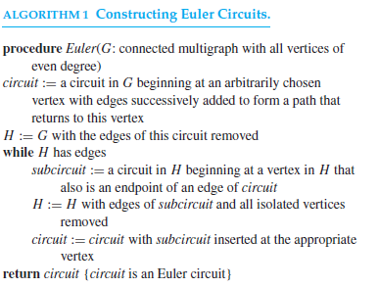
Algorithm 1
P732
*
School of Computer Science, BUPT
*

Slide 19
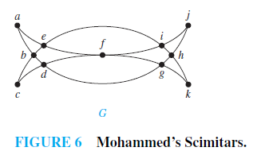
Example 3
Draw a picture in a continuous motion without lifting a pencil so that no part of the picture is retraced.
*
School of Computer Science, BUPT
*

Slide 20
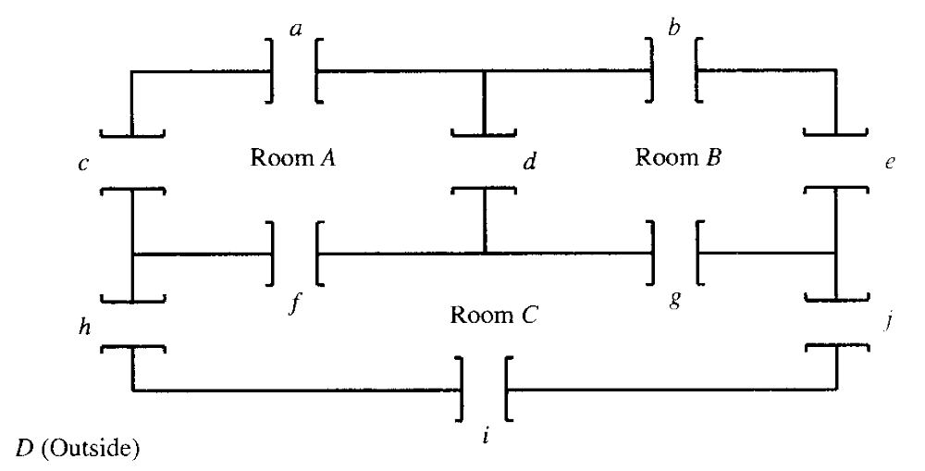
Example
The problem is this: Is it possible to begin in a room or outside and take a walk that goes through each door exactly once?
*
School of Computer Science, BUPT
*

Slide 21
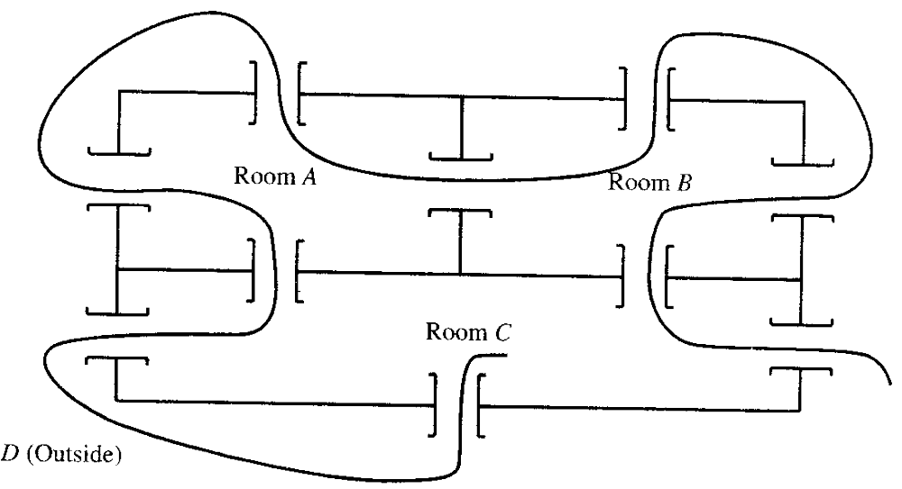
Example
*
School of Computer Science, BUPT
*

Slide 22

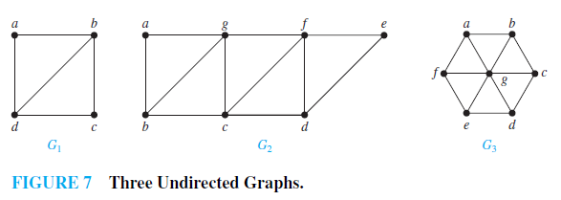
多选题
1分
Which graphs shown in Figure 7 have an Euler path?
A
G₁
B
G₂
C
G₃
提交
*
School of Computer Science, BUPT
*

Slide 23
APPLICATIONS OF EULER PATHS AND CIRCUITS
each street in a neighborhood
each road in a transportation network
each connection in a utility grid
each link in a communications network
Chinese postman problem in honor of Guan Meigu，who posed it in 1962.
*
School of Computer Science, BUPT
*

Slide 24
Hamilton Paths and Circuits（哈密顿路径与回路）

Slide 25
Hamiltonian Graph（哈密顿图）
A graph has a Hamiltonian tour if there is a tour that visits every vertex exactly once (and returns to its starting point).
A graph with a Hamiltonian tour is called a Hamiltonian graph.
A Hamiltonian path is a path that contains each vertex exactly once.
A Hamilton circuit is a circuit that traverses each vertex in G exactly once.
A Hamilton path is a path that traverses each vertex in G exactly once
*
School of Computer Science, BUPT
*

Slide 26
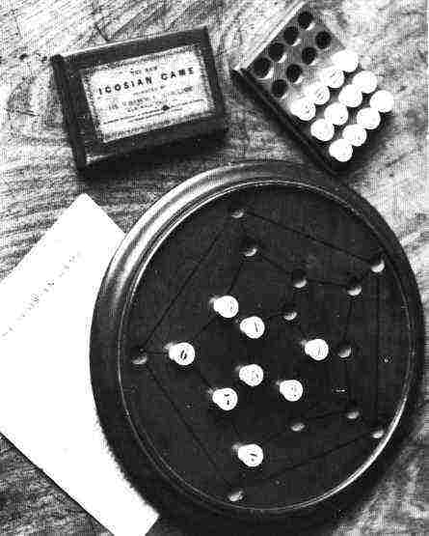
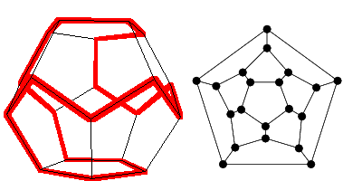
Round-the-World Puzzle
Can we traverse all the vertices of a dodecahedron, visiting each once?`
Equivalent
graph
Dodecahedron puzzle
Pegboard version
*
School of Computer Science, BUPT
*

Slide 27
Is it Hamiltonian?
A graph of the vertices of a dodecahedron.
Yes.
*
School of Computer Science, BUPT
*

Slide 28
Euler tour
Hamiltonian tour
Left one has a Hamiltonian path, but not a Hamiltonian tour.
Right one has an Euler tour, but no Hamiltonian tour.
*
School of Computer Science, BUPT
*

Slide 29
Question?
Given a graph, what is a fast way to determine if it is Hamiltonian? Can we give a characterization of Hamiltonian graphs that is as simple as the one for Eulerian graphs?
*
School of Computer Science, BUPT
*

Slide 30
No one knows
There is probably no nice characterization of Hamiltonian graphs the way there was with Eulerian graphs.
  Deciding if a graph is Hamiltonian is NP−complete.
    This means, if an algorithm for solving it in polynomial time were found, it could be used to solve all NP problems in polynomial time.
*
School of Computer Science, BUPT
*

Slide 31
Partial result
We now state some partial answers that say if a graph G has "enough" edges, a Hamiltonian circuit can be found.
These are again existence statements; no method for constructing a Hamiltonian circuit is given.
*
School of Computer Science, BUPT
*

Slide 32
Theorem 3,4
ORE’S THEOREM: If G is a simple graph with n vertices with n ≥ 3 such that deg(u) + deg(v) ≥ n for every pair of nonadjacent vertices u and v in G, then G has a Hamilton circuit.
  DIRAC’S THEOREM: If G is a simple graph with n vertices with n ≥ 3 such that the degree of every vertex in G is at least n/2, then G has a Hamilton circuit.
*
School of Computer Science, BUPT
*

Slide 33
Theorem
Let the number of edges of G be m.
Then G has a Hamiltonian circuit if
  m≥(n²-3n-6)/2.
*
School of Computer Science, BUPT
*

Slide 34
Proof
Suppose that u and v are any two vertices of G that are not adjacent.
  We write deg(u) for the degree of u.
Let H be the graph produced by eliminating u and v from G along with any edges that have u or v as end points.
Then H has n-2 vertices and m-deg(u)-deg(v) edges (one fewer edge would have been removed if u and v had been adjacent).
*
School of Computer Science, BUPT
*

Slide 35
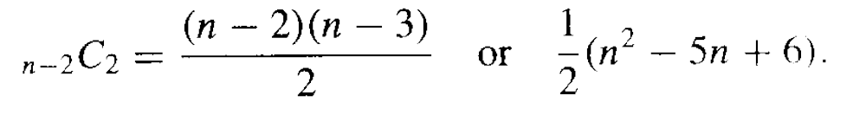
Proof
The maximum number of edges that H could possibly have is _{n-2}C₂.This happens when there is an edge connecting every distinct pair of vertices. Thus the number of edges of H is at most
*
School of Computer Science, BUPT
*

Slide 36
Proof
So
  m - deg(u) - deg(v) ≤ (n² - 5n + 6)/2.
Therefore
  deg(u)+deg(v) ≥ m - (n² - 5n + 6)/2.
By the hypothesis of the theorem,
  deg(u)+deg(v) ≥ (n²-3n-6)/2 - (n²-5n+6)/2 = n.
Thus the result follows from Theorem 3.
*
School of Computer Science, BUPT
*

Slide 37
Note
The converses of Theorems 3 and 4 given above are not true; that is, the conditions given are sufficient, but not necessary, for the conclusion.
*
School of Computer Science, BUPT
*

Slide 38
Applications of Hamilton Circuits
each road intersection in a city
each place pipelines intersect in a utility grid
each node in a communications network.
The famous traveling salesperson problem or TSP
the edges may have weights representing distance, cost, and the like. The problem is then to find a Hamiltonian circuit (or path) for which the total sum of weights in the path is a minimum.
*
School of Computer Science, BUPT
*

Slide 39
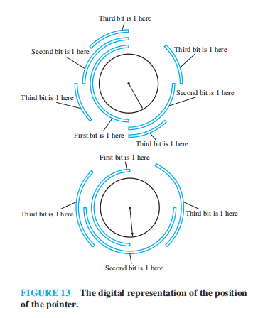
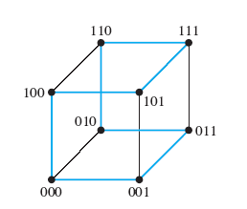
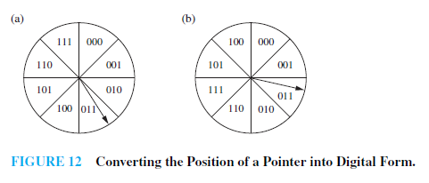
Gray Codes
A Gray code is a labeling of the arcs of the circle such that adjacent arcs are labeled with bit strings that differ in exactly one bit.
P737-738
*
School of Computer Science, BUPT
*

Slide 40
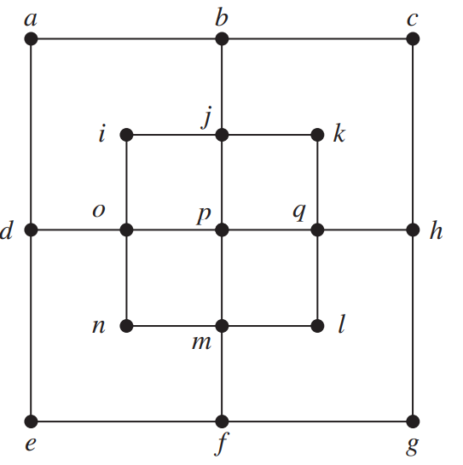
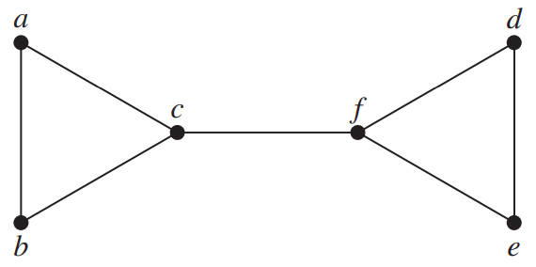
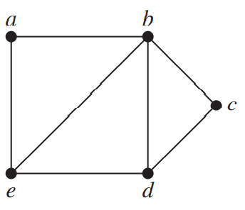
多选题
1分
Determine which of the given graphs have a Hamilton circuit.
a
b
A
a
c
B
b
C
c
提交
*
School of Computer Science, BUPT
*

Slide 41
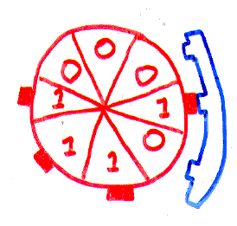
Rotating memory drum （旋转鼓轮）
“Modern” application:memory wheel
Address decoder
*
School of Computer Science, BUPT
*

Slide 42
Rotating memory drum
Is there a memory wheel with 16 bits in which all 4-bit patterns occur?
Is there a memory wheel with 2^{n} bits in which all n-bit patterns occur?
*
School of Computer Science, BUPT
*

Slide 43
000
100
001
010
1
0
0
1
0
101
1
1
0
110
011
111
There is an arrow from node a to node b if the last two bits in a equal the first two bits in b.
There is a 1-1 correspondence between Hamiltonian tours of this graph and memory wheels with 8 bits.
*
School of Computer Science, BUPT
*

Slide 44
Hamiltonian graph?
0000
0001
0011
0010
0111
0110
0101
0100
1011
1010
1001
1000
1101
1100
1110
1111
*
School of Computer Science, BUPT
*

Slide 45
Different representation
Perhaps a different graph can represent the same problem.
Hint: It’s better to be looking for Eulerian tours than Hamiltonian tours.
*
School of Computer Science, BUPT
*

Slide 46
Idea
Instead of having the nodes be the 3-bit patterns, and putting an edge between patterns with a 2-bit overlap,……
Have the nodes be the 2-bit overlap and the edges the 3-bit pattern.
abc
ab
bc
bcd
cd
*
School of Computer Science, BUPT
*

Slide 47
The result is
Every Euler tour corresponds to a memory wheel.
000
00
001
100
010
01
10
101
011
110
11
111
*
School of Computer Science, BUPT
*

Slide 48
0000
000
1000
0001
100
1001
001
0100
0010
010
0
1
1
1100
1010
0101
0011
1
1
1
1
101
0
0
1101
1011
0
0
110
0110
011
1
0
0
0
1
111
1110
0111
*
1111
School of Computer Science, BUPT
*

Slide 49
Theorem
For every n, there exists a memory wheel of size 2^{n} that has all n-bit patterns.
Proof
  There are 2 edges in and 2 edges out of every vertex. Graph is connected – can find path from any a to any b.Thus the graph is Eulerian. Every Euler tour corresponds to a memory wheel.
*
School of Computer Science, BUPT
*

Slide 50
0000
1000
0001
1001
0100
0010
1100
1010
0101
0011
1101
1011
0110
1110
0111
1111
*
School of Computer Science, BUPT
*

Slide 51
Please feel free
to ask questions!
((( )))
*
School of Computer Science, BUPT
*

Slide 52
homework
§10.5
  8, 10, 16, 26, 34, 48
  58(optional)
*
School of Computer Science, BUPT
*

